Slide 1

SAI VIDYA INSTITUTE OF TECHNOLOGY
Department of Computer Science and Engineering
Rajanukunte, Bengaluru - 560064
Project Final Phase
QUALITY ANALYSIS AND SHELF-LIFE PREDICTION OF FRUITS AND VEGETABLES USING DEEP LEARNING
By
Vaishnavi A 1VA18CS053
Santhosh K 1VA18CS039
Suhas M 1VA18CS048
Tejas Manu S 1VA18CS052
Under the guidance of
Prof. Kshama S B
Assistant Professor
Computer Science and Engineering

Slide 2
Department Vision & Mission
Vision
Contribute dedicated, skilled, intelligent Computer engineers to architect strong India and the world
Provide quality education in Computer science by promoting excellence in Instruction, Research and Practice.
Promote Professional interaction and Lifelong Learning.
Encourage the youths to pursue career in computer domain with modern innovation and ethics.
Mission

Slide 3
Presentation Outline
Introduction
Problem Statement
Literature Survey
System Requirement Specification
System methodology
Flowchart
Project Modules
Implementation
Snapshots
Conclusion
References
Dept. of ISE, SVIT 3

Slide 4
Introduction
India is an agricultural country where a variety of fruits and vegetables are grown and produced for consumption as well as export.
India is at second position after China in production of fruits.
Texture, Color & freshness are the important parameters for fruit quality identification.
The color recognition is very important process in ripeness detection.
The ripeness detection is external quality factor. It is also important to check for any bacterial/fungal growth on the fruit/vegetable.
Because of these various factors, defected fruits can be recognized.
Dept. of ISE, SVIT 4

Slide 5
Problem Statement
To detect the quality of the fruits and vegetables using image classification and object detection.
Defect or damage usually occurs in fruit and vegetables due to various factors such as rotting, bruising, scab, fungal growth, injury, disease etc. The image classification helps to identify the rotten/defected fruit and object detection helps in detecting it in real-time.
Dept. of ISE, SVIT 5

Slide 6
Literature Survey
NO. | PAPER TITLE | YEAR OF PUBLISH | LITERATURE SURVEY
1 | Real-time visual inspection system for grading fruits using computer vision and deep learning techniques | 2021 | The results of this study show that Efficient Net CNN models and their stacked combinations have the highest accuracy in grading the test set and real samples as compared to the other deep learning models. In the proposed system, classification is solely based on the outer appearance of the fruit and it only uses single view of the fruits’ images.
2 | A role of computer vision in fruits and vegetables among various horticulture products of agriculture fields | 2020 | Recognition and classification of fruits and vegetable and also detection of disease in fruits and vegetable among the horticulture product under agriculture field using computer vision. One major disadvantage in the use of Computer Vision is the preparation of dataset, that is Hercules task and it is too much time-consuming.
3 | Maturity status classification of papaya fruits based on machine learning and transfer learning approach | 2020 | This paper proposed a classification model for maturity status classification of papaya fruits in two approaches, machine learning and transfer learning approach. In overall, the VGG19 is better as VGG19 is based on transfer learning, there is no requirement of feature extraction and feature selection process. Although transfer learning approach needs complex architecture, high training time and large datasets for but it is one time only. The accuracy is 100%.
Dept. of ISE, SVIT 6

Slide 7
Literature Survey
NO. | PAPER TITLE | YEAR OF PUBLISH | LITERATURE SURVEY
4 | Automatic Fruit Classification Using Deep Learning for Industrial Applications | 2019 | An efficient framework for fruit classification using deep learning. More specifically, the framework is based on two different deep learning architectures. The first is a proposed light model of six convolutional neural network layers, whereas the second is a fine-tuned visual geometry group-16 pre-trained deep learning model.
5 | Ripeness Classification of Bananas Using an Artificial Neural Network | 2019 | In this paper, an automatic computer vision system is proposed to identify the ripening stages of bananas. A four-class homemade database is prepared. Then artificial neural network-based framework which uses color, development of brown spots to classify and grade banana fruit ripening stage. Results and the performance of the proposed system are compared with various techniques such as the naive Bayes, the KNN, the decision tree, and discriminant analysis classifiers.
Dept. of ISE, SVIT 7

Slide 8
SYSTEM REQUIREMENT SPECIFICATION
Hardware Requirements:
Hardware requirements for the implementation and testing this project are mentioned as below:
Raspberry Pi, Pi camera, LCD screen and SD card.
Software Requirements:
Software requirements for the implementation and testing of this project are mentioned as below:
Operating system : Windows XP / 7
Language: Python
Open source libraries: Tensorflow, OpenCV, Kaggle, google public data explorer, UCI Machine Learning repository and self collected data.
Dept. of ISE, SVIT 8

Slide 9
SYSTEM REQUIREMENT SPECIFICATION
Functional Requirements:
The pi camera will capture the image and then pass it on to the model.
the model will then classify the fruit/vegetable as good or bad based on image classification and architecture of the model.
The model will also display to the user the shelf life of the fruits and vegetable.
This wil be displayed to the user on an LCD screen.
Non Functional Requirements:
They basically deal with issues like :
Security
Maintainability
Reliability
Scalability
Performance
Dept. of ISE, SVIT 9

Slide 10
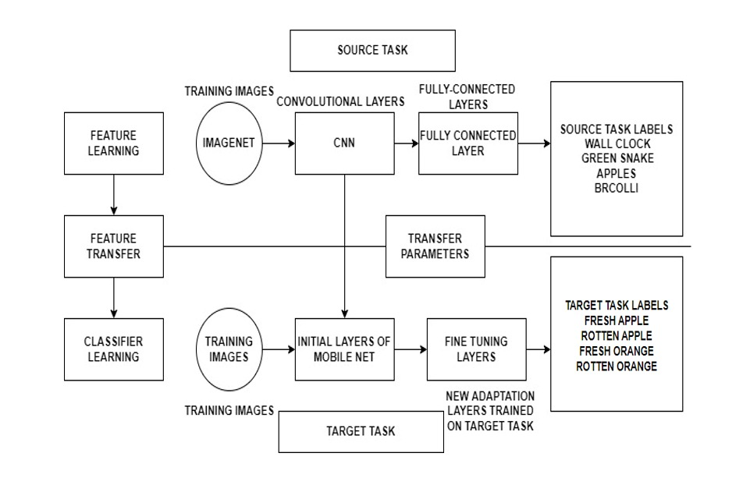
SYSTEM METHODOLOGY
Dept. of CSE, SVIT 10

Slide 11
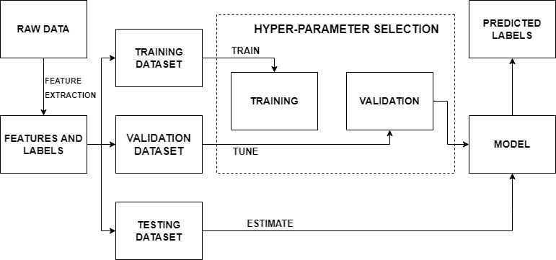
FLOWCHART
Dept. of CSE, SVIT 11

Slide 12
Project Modules
Transfer learning
Anvil
Quality detection
Image processing
Shelf life prediction
14000 images (Dataset)
Dept. of ISE, SVIT 12

Slide 13
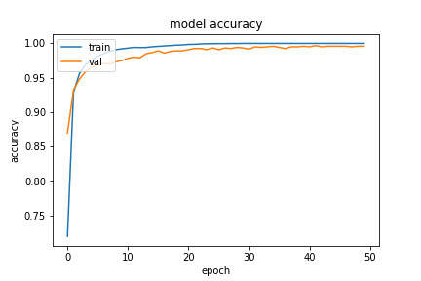
IMPLEMENTATION
This graph represents the training and validation accuracy of the image classification model.
The model has achieved 100% training accuracy and 99.58% validation accuracy.
Dept. of CSE, SVIT 13

Slide 14
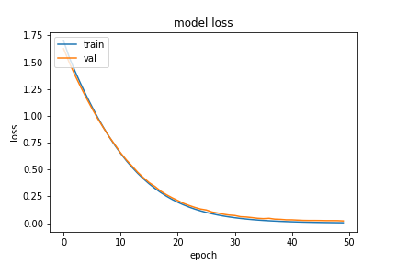
IMPLEMENTATION
This graph represents the training and validation loss of the image classification model.
The model has achieved minimum training loss of 0.35% loss and validation loss of 0.2%.
Dept. of CSE, SVIT 14

Slide 15
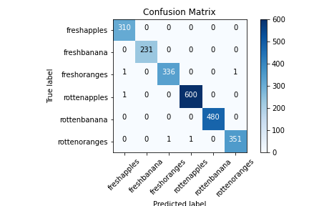
IMPLEMENTATION
This fig shows the confusion matrix of the model.
The model performs remarkably good on the test dataset by misclassifying only 5 instances out of 2,313 test data.
Dept. of CSE, SVIT 15

Slide 16
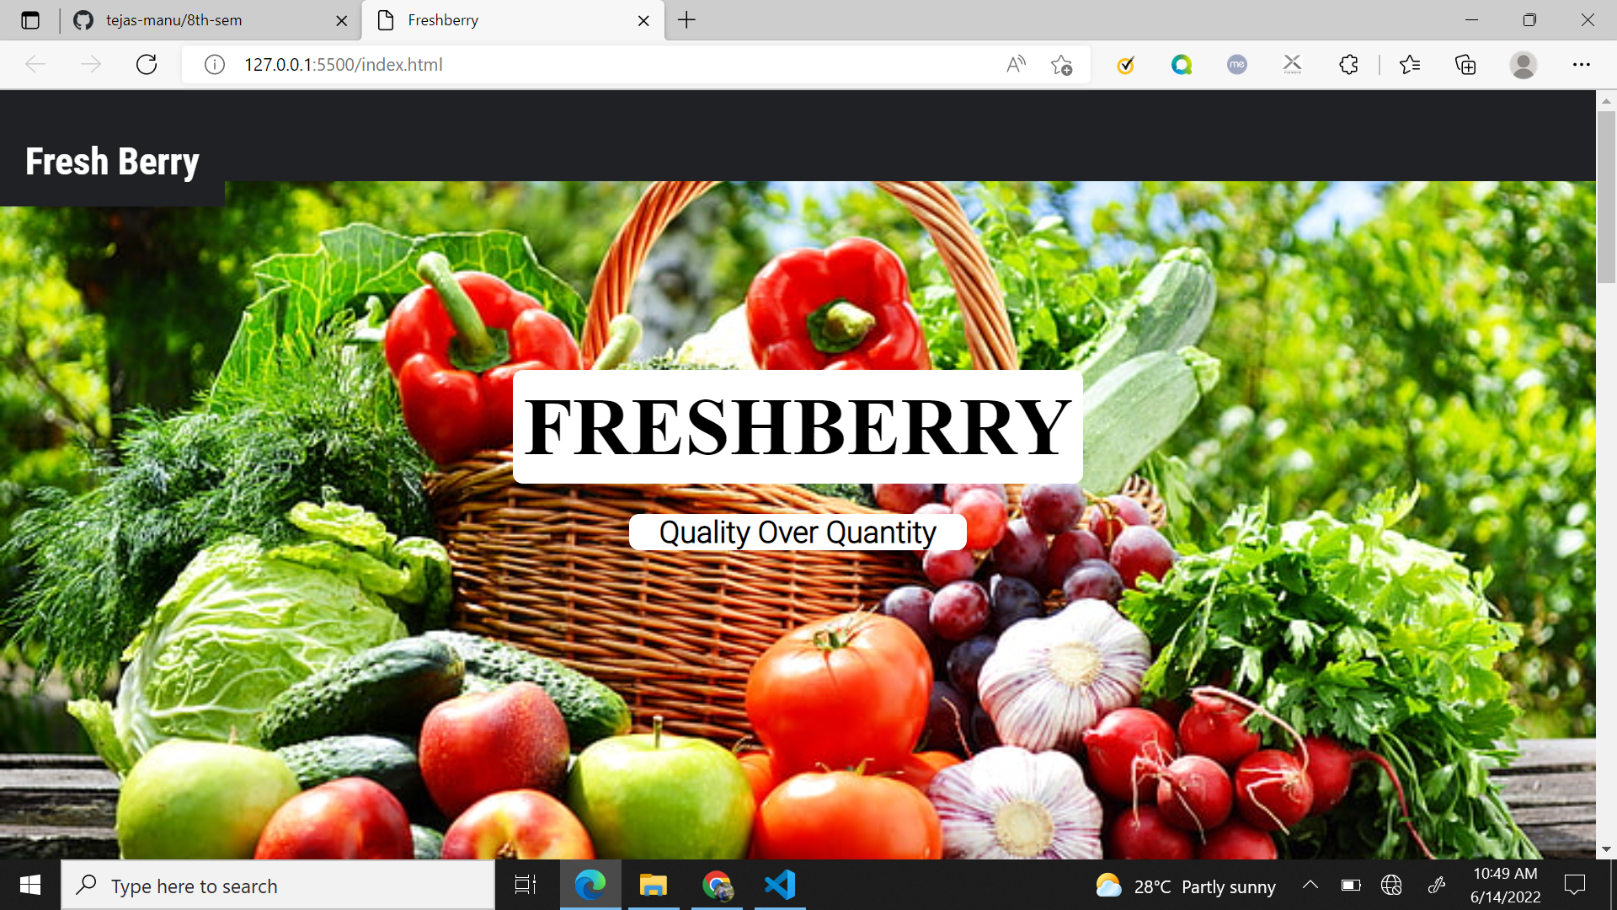
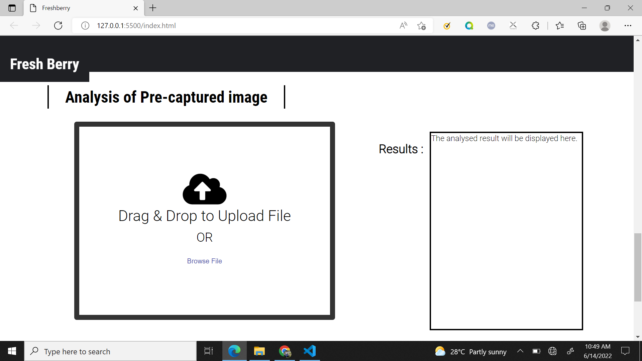
Snapshots
Dept. of CSE, SVIT 16

Slide 17
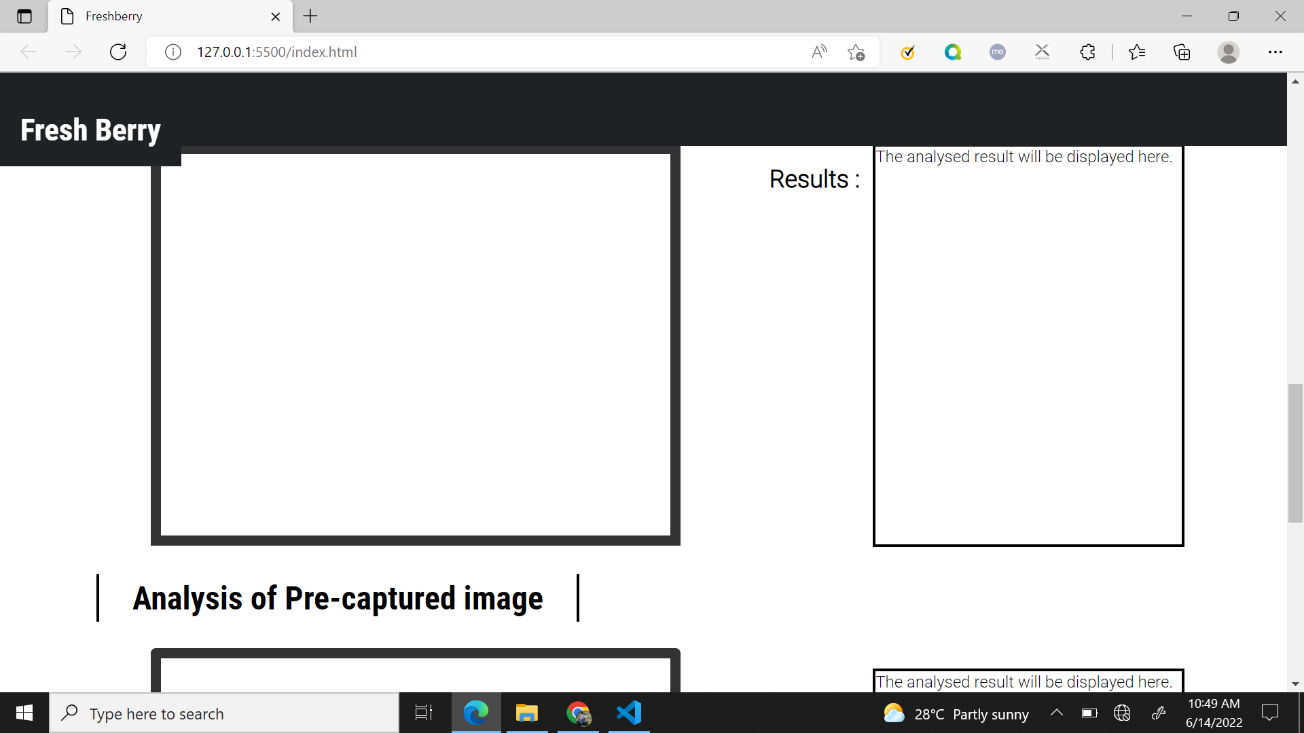
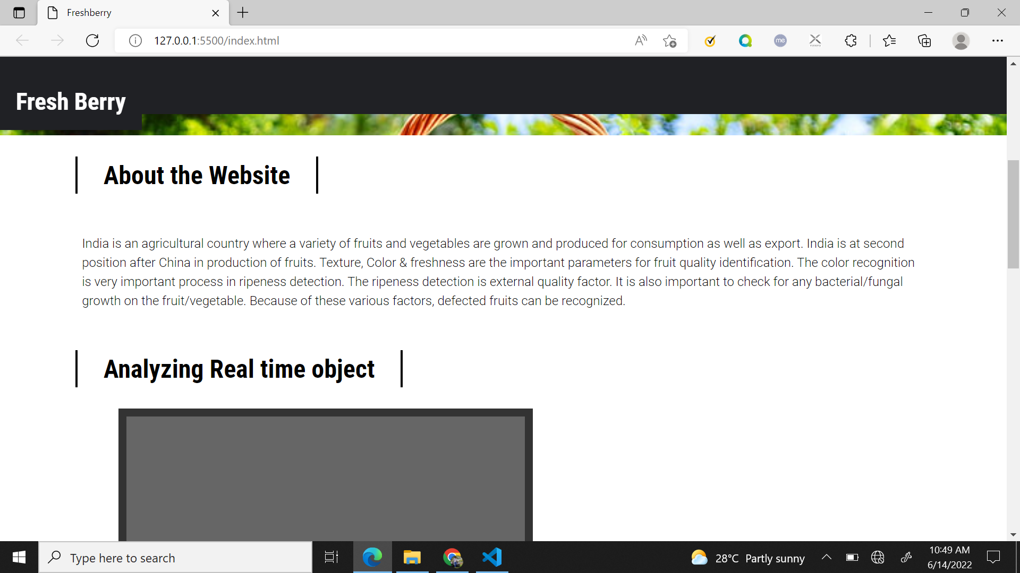
Snapshots
Dept. of CSE, SVIT 17

Slide 18
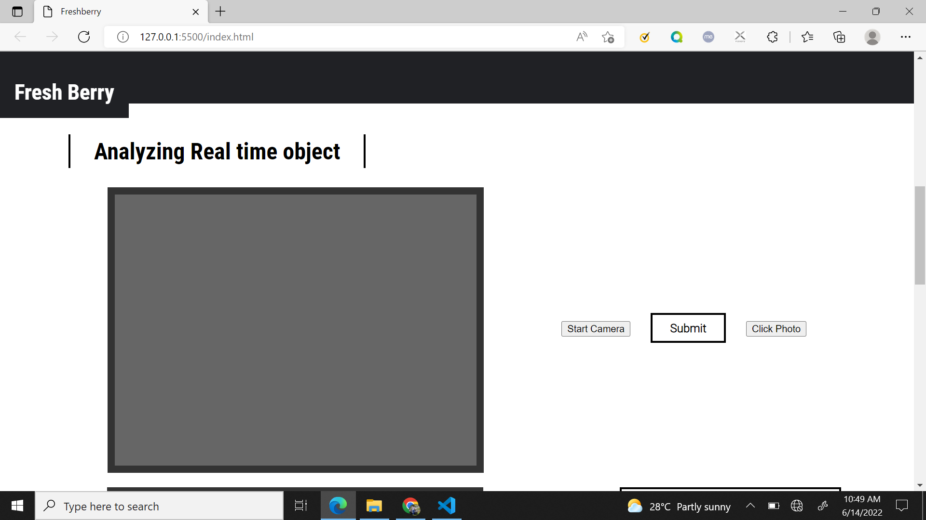
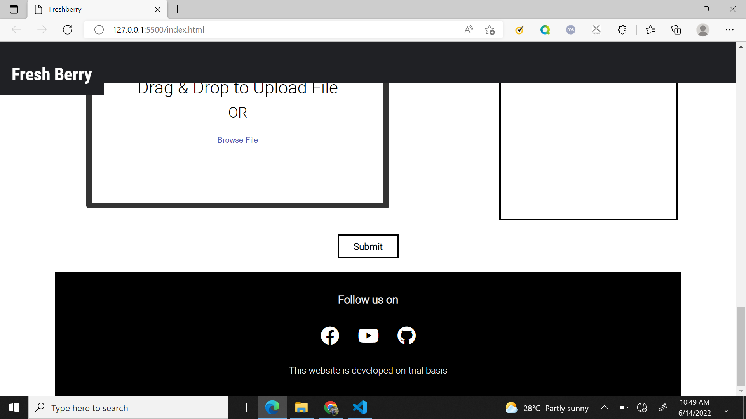
Snapshots
Dept. of ISE, SVIT 18

Slide 19
CONCLUSION
Thus we conclude that this study is strongly advisable to use as a developed system for detecting fruit and vegetable defects.
Based on the dataset given, it will detect the undesirable fruits and vegetable through image classification and then determine the shelf life of these fruits and vegetables. These will be implemented using Transfer learning and high accuracy for the same will be achieved by using different architectures.
Based on these observations we can plan to develop a standardized framework for fruit and vegetable defects identification and classification.
Dept. of CSE, SVIT 19

Slide 20
References
[1] Real-time visual inspection system for grading fruits using computer vision and deep
learning techniques by Nazrul Ismail & Owais A.Malik. [March 2022]
[2] A role of computer vision in fruits and vegetables among various horticulture
products of agriculture fields: A survey by Mukesh KumarTripathi and Dr Dhananjay D.Maktedar. [June 2020]
[3] Maturity status classification of papaya fruits based on machine learning and transfer
learning approach by Santi Kumari Behera, Amiya Kumar Rath and Prabira Kumar Sethy. [June 2021]
[4] Automatic Fruit Classification Using Deep Learning for Industrial Applications by
M. Shamim Hossain, Muneer Al-Hammadi and Ghulam Muhammad. [October 2018]
[5] Ripeness Classification of Bananas Using an Artificial Neural Network by Fatma M.
A. Mazen & Ahmed A. Nashat. [January 201]
Dept. of ISE, SVIT 20

